Slide 1
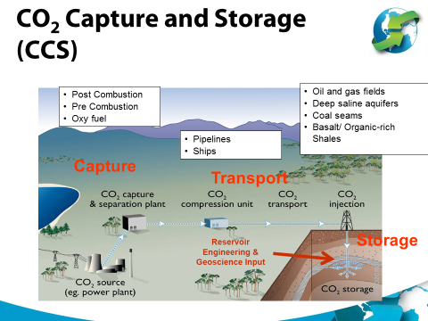
Tim Dixon | Programme Manager | IEAGHG
Pure Offices. Cheltenham Office Park. Hatherley Lane. Cheltenham. GL51 6SH. UK . tel: +44 (0)1242 802988

